Slide 1
Deep Learning
INNOVATIVE EXAM PS-2
AI&ML GROUP 4
16-Sagar Kenekar
15-Rishabh Jha
14-Meet Jain
13-Gaurav Indorkar
Notes:
gaurav

Slide 2
Presentation Outline
Overview
Deep Neural Networks
Procedure To Create A Deep Learning Model
Current Scenario and Market Trends on Deep Learning
Introduction to Topic
Need Of Deep Learning
Deep Learning in Industrial Revolution 4.0
Deep Learning in Medical Field
Deep Learning in IOT Industry
Company’s Working on DEEP LEARNING AND OTHER MNCS EXAMPLES
Need, Uses & Application of Deep Learning
References
Thank you & Credits
Notes:
gaurav

Slide 3
Introduction to Topic
Notes:
sagar

Slide 4
Overview
Deep Learning is the Subset of Machine Learning, Which Attempts to Simulate Behaviour of Human Brain Through Complex Neural Network.
Deep learning drives many artificial intelligence (AI) applications and services that improve automation, performing analytical and physical tasks without human intervention.
Some Applications of Deep Learning Technology In Everyday Life are:
digital assistants
voice-enabled TV remotes
credit card fraud detection
self-driving cars
Machine learning and deep learning models are capable of different types of learning as well, which are usually categorized as:
supervised learning,
unsupervised learning,
reinforcement learning.
To do Deep Learning we use keras, Scikit-learn, Tensor flow, etc types of various Libraries
Notes:
sagar

Slide 5
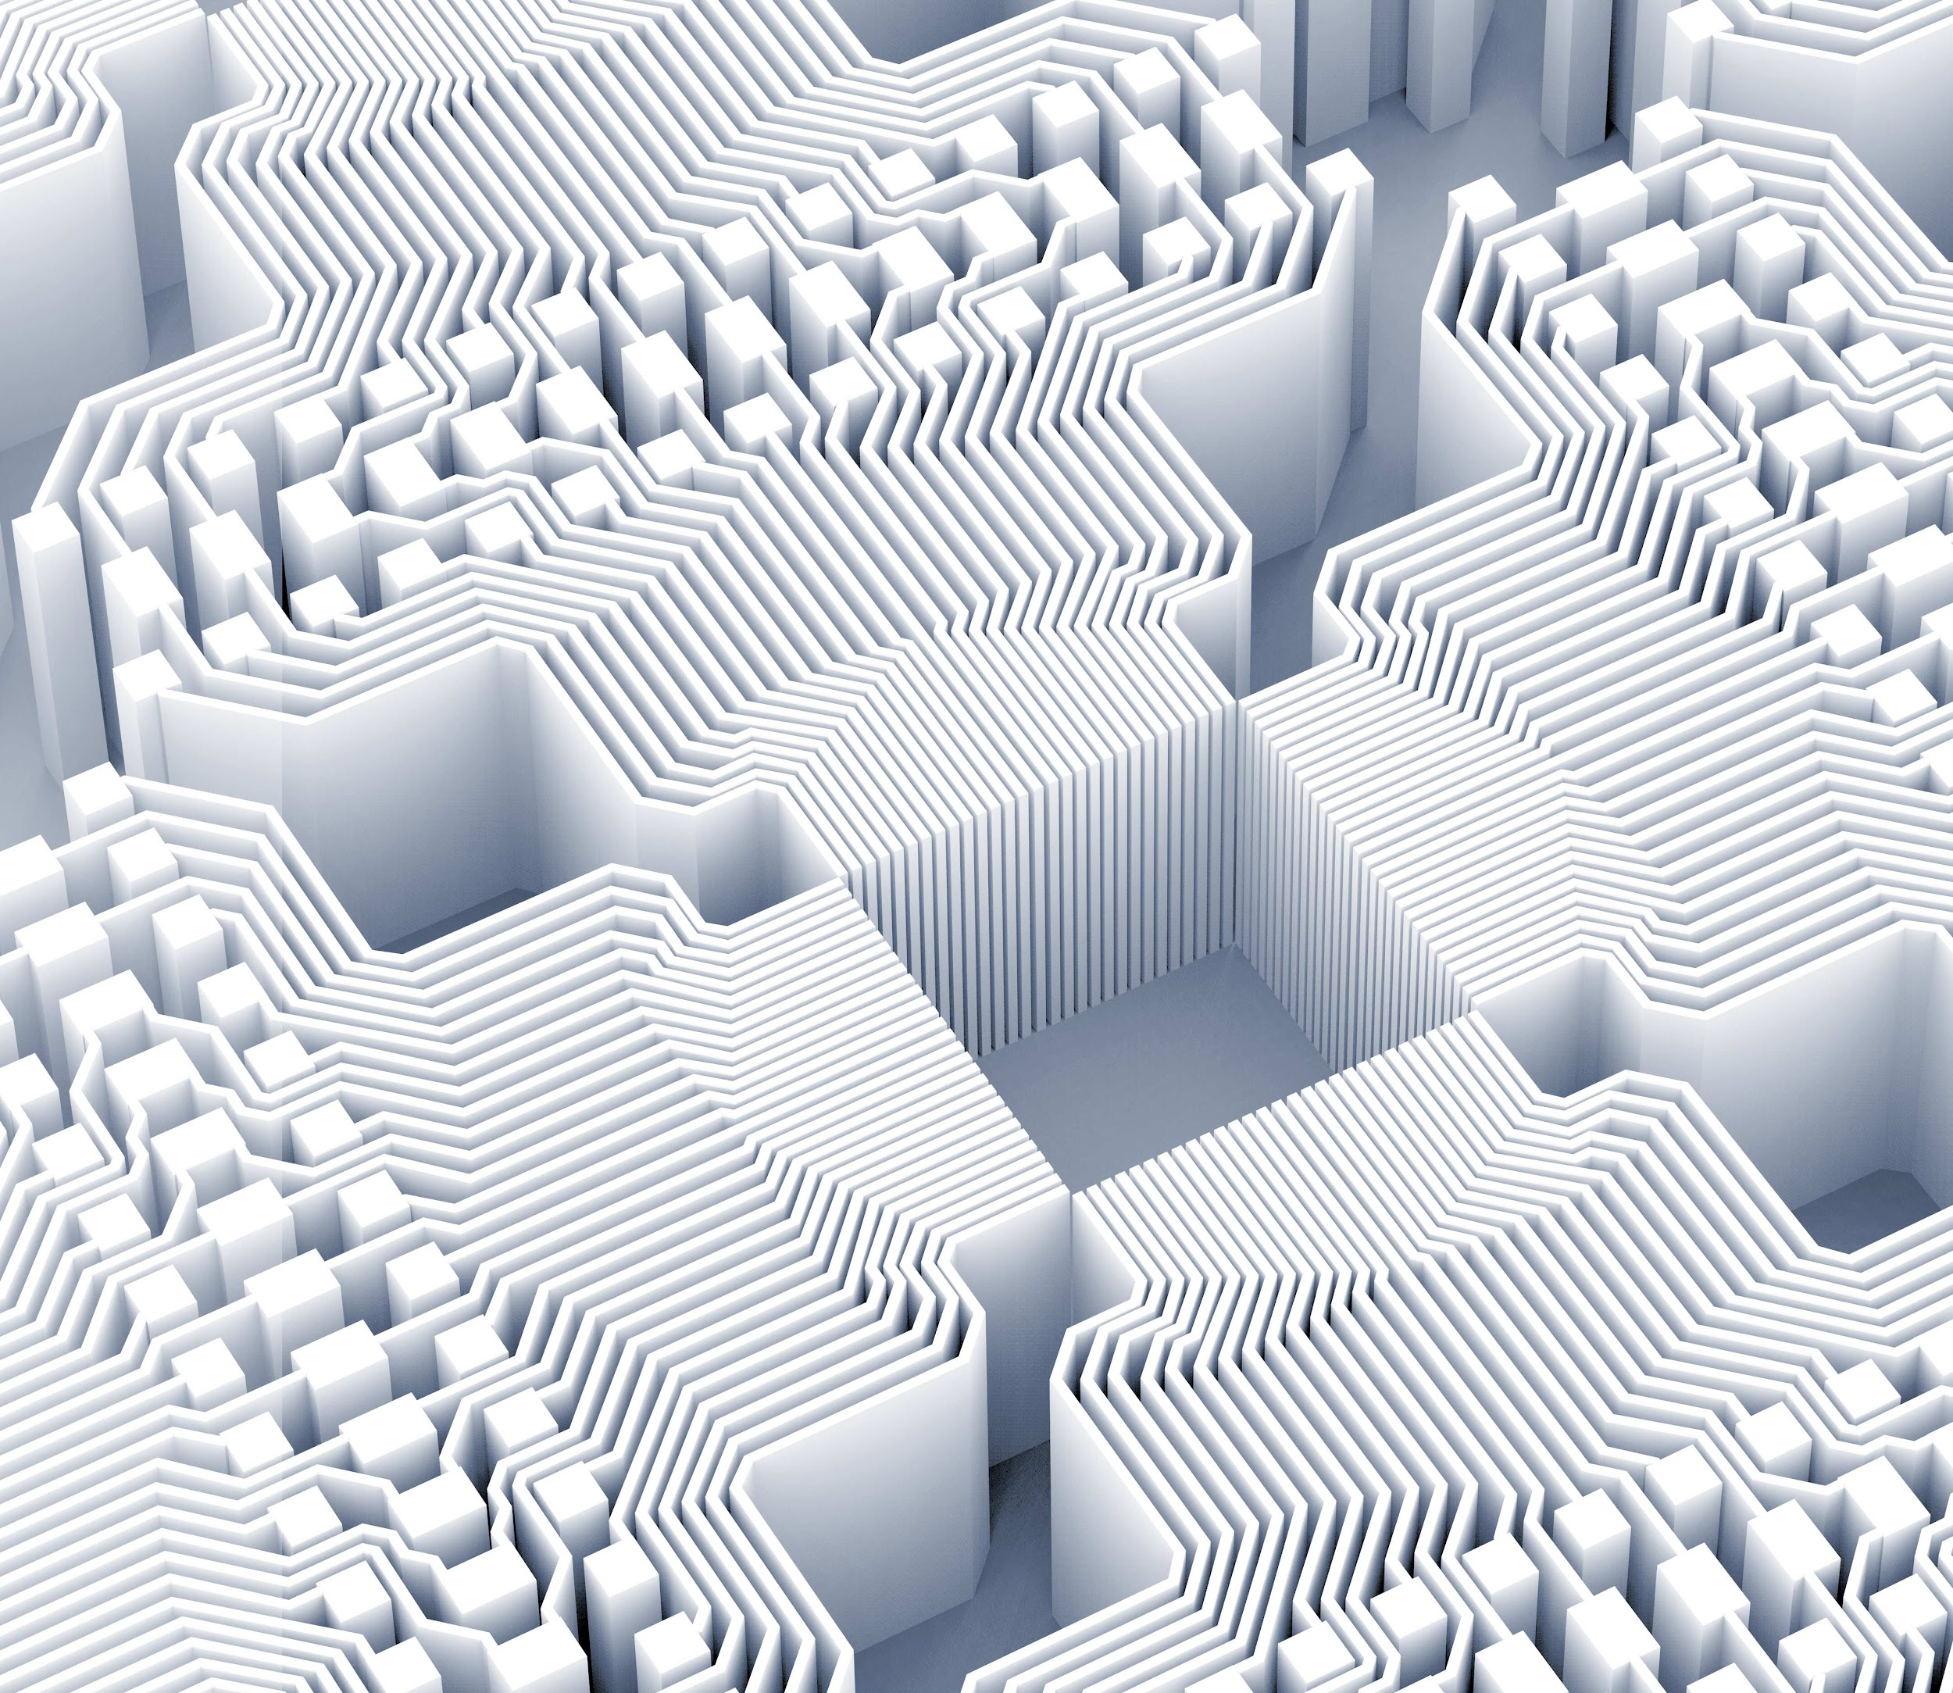
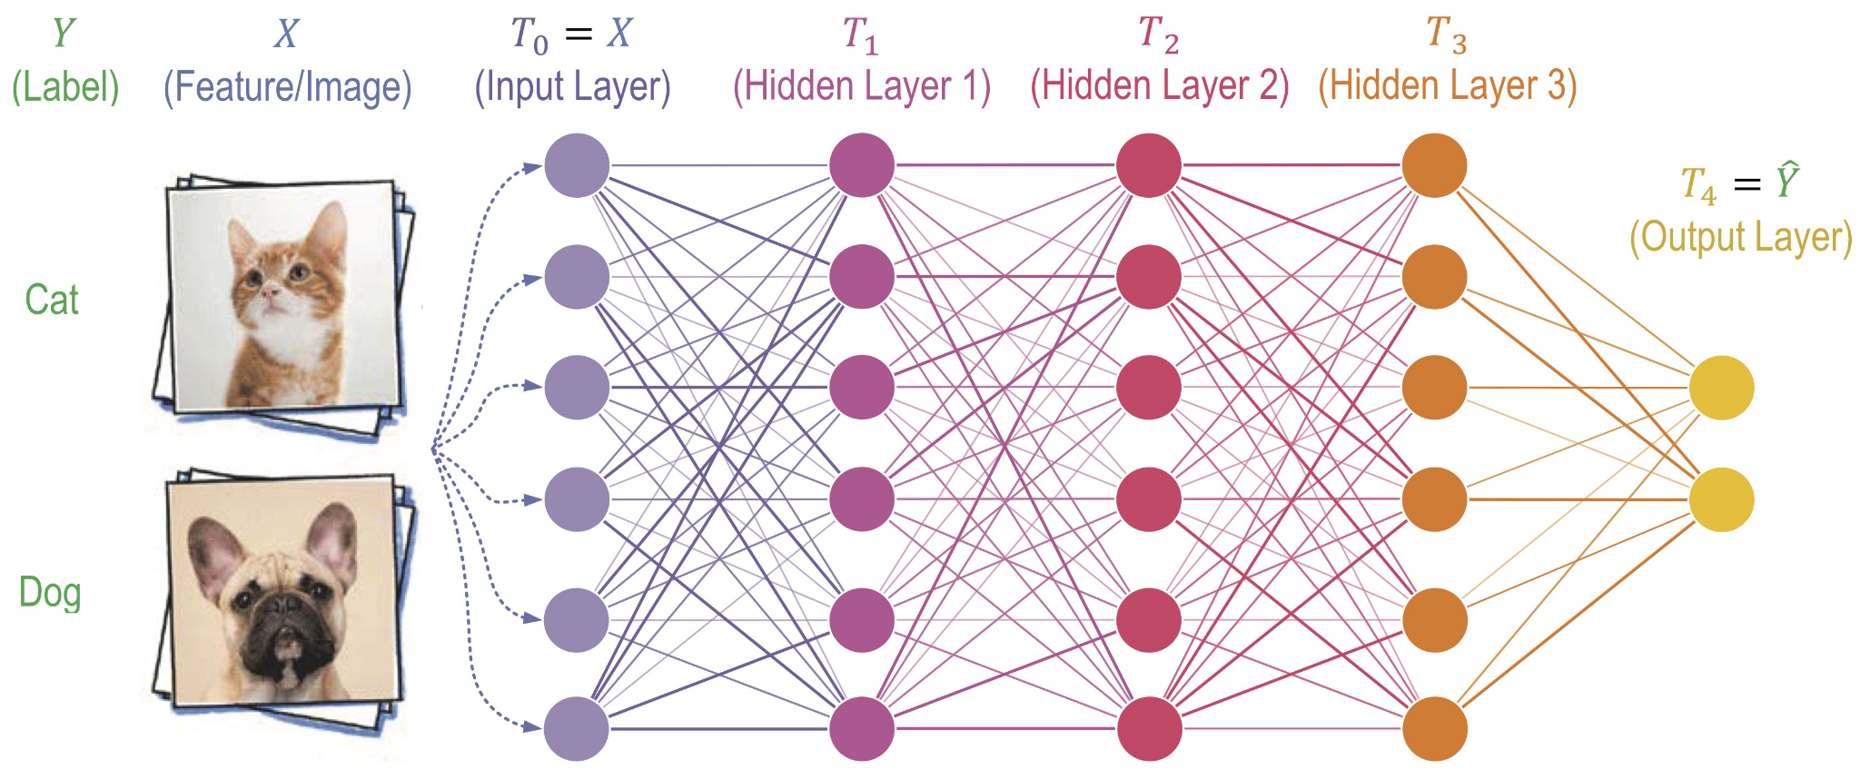
Deep Neural Networks
A deep neural network (DNN) is an artificial neural network (ANN) with multiple layers between the input and output layers.
Each mathematical manipulation as such is considered a layer,and complex DNN have many layers, hence the name "DEEP" networks.
These components as a whole function similarly to a human brain, and can be trained like any other ML algorithm.
For example, a DNN that is trained to recognize dog breeds will go over the given image and calculate the probability that the dog in the image is a certain breed.
Notes:
raishab

Slide 6
Procedure To Create A Deep Learning Model
04
Improving the Model Accuracy
Data Pre-Processing
01
03
Build Artificial Neural Network
Running Prediction on the Test Set
02
Notes:
meet

Slide 7
Procedure to Create A Deep Learning Model
Step 1
Step 2
Step 3
Step 4
Step 5
Step 6
Data Pre-Processing
Separating Training & Testing Dataset
Build Artificial Neural Network
Running Prediction on the Test Set
Checking for Confusion Matrix
Improving the Model Accuracy
Notes:
meet

Slide 8
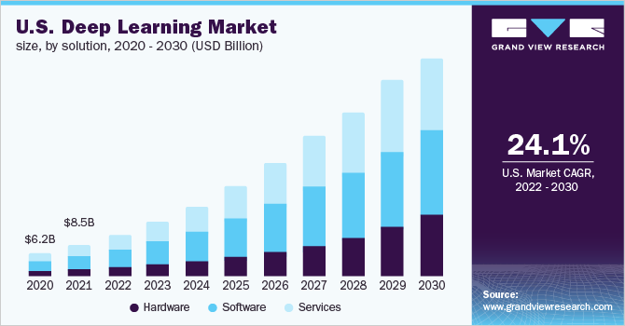
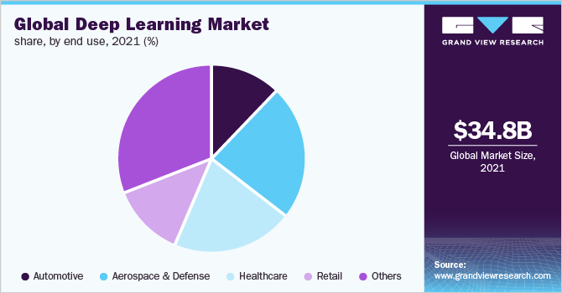
Current and Market Trends on Deep Learning
Currently major Market Leaders and Billionaires are investing in Deep Learning Technology
According to Market Insights Deep Learning Can bring a Humongous Change
Notes:
gaurav

Slide 9
Current Scenario and Market Trends on Deep Learning
Report Attribute | Details
Market size value in 2022 | USD 49.6 billion
Revenue forecast in 2030 | USD 526.7 billion
Growth rate | CAGR of 34.3% from 2022 to 2030
Forecast period | 2022 - 2030
Quantitative units | Revenue in USD billion and CAGR from 2022 to 2030
Key Companies Profiled | Advanced Micro Devices, Inc.; ARM Ltd.; Clarifai Inc.; Entilic; Google, Inc.; HyperVerge; IBM ; Intel ; Microsoft ; NVIDIA ; Deep Mind ; Open Ai ; NASA ; ISRO ; DRDO ; SpaceX
Notes:
Gaurav cagr compound annual growth rate

Slide 10
Need, Uses & Application of Deep Learning
Notes:
Rishabh

Slide 11
Need Of Deep Learning
01
Deep learning is an important element of data science, which includes statistics and predictive modeling. It is extremely beneficial to data scientists who are tasked with collecting, analyzing and interpreting large amounts of data; deep learning makes this process faster and easier.
02
Deep learning is an emerging subfield of machine learning. It employs artificial neural network (ANN) algorithms to process data, derive patterns or to develop abstractions, simulating the thinking process of a biological brain. And those ANNs usually contain more than one hidden layer, which is how deep learning got its name—machine learning with stacked neural networks. Going beyond shallow ANNs (usually with only one hidden layer), a deep learning model with the right architectures and parameters can better represent complex non-linear relationships.
03
Deep learning employs a stack of multiple hidden layers of non-linear processing units. The input of a hidden layer is the output of its previous layer. This can be easily observed from the examples of a shallow neural network and a deep neural network shown previously.
Notes:
Rishabh

Slide 12
Deep Learning in Industrial Revolution 4.0
Industry 4.0 is revolutionizing the way companies manufacture, improve and distribute their products. Manufacturers are integrating new technologies, including Internet of Things (IoT), cloud computing and analytics, and AI and machine learning into their production facilities and throughout their operations.
These smart factories are equipped with advanced sensors, embedded software and robotics that collect and analyze data and allow for better decision making. Even higher value is created when data from production operations is combined with operational data from ERP, supply chain, customer service and other enterprise systems to create whole new levels of visibility and insight from previously siloed information.
Using high-tech IoT devices in smart factories leads to higher productivity and improved quality. Replacing manual inspection business models with AI-powered visual insights reduces manufacturing errors and saves money and time. With minimal investment, quality control personnel can set up a smartphone connected to the cloud to monitor manufacturing processes from virtually anywhere. By applying machine learning algorithms, manufacturers can detect errors immediately, rather than at later stages when repair work is more expensive.
Notes:
Sagar

Slide 13



Deep Learning in Medical Field
MEDICAL IMAGING AND DIAGNOSTICS
DRUG DISCOVERY
SIMPLIFYING CLINICAL TRIALS
IMPROVED HEALTH RECORD AND PATIENT MONITORING
DERIVING INSIGHTS AND ACCURATE RESULTS
1
2
3
4
5
Notes:
sagar

Slide 14
Deep Learning X IOT Industry = MASSIVE CHANGE
In recent years, the techniques of Internet of Things (IoT) and mobile communications have been developed to detect and collect human and environment information (e.g. geo-information, weather information, bio-information, human behaviors, etc.) for a variety of intelligent services and applications. The three layers in IoT are the sensor, networking, and application layers; several techniques and standards (e.g. oneM2M, Open Connectivity Foundation, etc.) have been proposed and established for these three layers. For the sensor and networking layers, the rise of mobile technology advancements (e.g. wireless sensor networks, LoRaWAN, Sigfox, narrow band-IoT, etc.) has led to a new wave of machine-to-machine (M2M), machine-to-human (M2H), human-to-human (H2H), and human-to-machine (H2M) communications. For the application layer, the IoT techniques in several applications, including energy, enterprise, healthcare, public services, residency, retail, and transportation, have been designed and implemented to detect environmental changes and send instant updates to a cloud computing server farm via mobile communications and middleware for big data analyses. One of the perfect examples is that the vehicle on-board units can instantly detect and share information about the vehicle geolocation, speed, following distance, as well as gaps with other neighboring vehicles. Big data can be collected by IoT techniques and then analyzed by deep learning techniques for a variety of applications and services.
Deep learning techniques, e.g. neural network (NN), convolutional neural network (CNN), recurrent neural network (RNN), long short-term memory (LSTM), etc., have been popularly applied into image recognition and time-series inference for IoT applications. Advanced driver assistance systems and autonomous cars, for instance, have been developed based on machine learning and deep learning techniques, which perform forward collision warning, blind spot monitoring, lane departure warning, traffic sign recognition, traffic safety, infrastructure management and congestion, and so on. Autonomous cars can share their detected information, such as traffic signs, collision events, etc., with other cars via vehicular communication systems, e.g., dedicated short range communications (DSRC), vehicular ad hoc networks (VANETs), long term evolution (LTE), and 5th generation mobile networks for cooperation. However, how to enhance the performance and efficiency of these deep learning techniques is one of the big challenges for implementing these real-time applications.
Notes:
meet

Slide 15
Company’s Working on DEEP LEARNING AND OTHER MNCS EXAMPLES
Neurala Revenue USD 32.1 M : Founded in 2006, is a visual AI software pioneer. Neurala helps industrial companies improve their quality inspection process with technology that dramatically reduces the time, cost, and skills required to build and maintain production-quality custom vision AI solutions, as part of its mission to make AI more applicable and useful in real-world applications. Neurala's research team pioneered Lifelong-DNN (L-DNN) technology, which reduces data needs for AI model building and enables continuous learning in the cloud or at the edge,.
The United States Department of Defense applied deep learning to train robots in new tasks through observation
Deep Mind by google eg
Open ai chat gpt
DALL.E creates image if any search is given created by open ai company
You know all of this let us show you some different examples
OpenAI Revenue USD 27.4 M : Although enormous quantities of money have been obtained through investments and some through acquisitions, the non-profit research group focuses around the creation of AI for the benefit of all humanity and has managed to keep its open source mentality. OpenAI employs some of the most well-known individuals in AI, including deep learning expert Ilya Sutskever. Microsoft, Amazon, and Elon Musk are among its sponsors.
Qualcomm (Revenue USD 23.53 B : Qualcomm is a chipmaker dedicated to artificial intelligence. The Snapdragon 855 smartphone platform relies heavily on artificial intelligence. For AI voice, audio, and picture tasks, the chip uses a signal processor. Qualcomm Snapdragon processors are found in some of the most popular smartphones.
Notes:
meet

Slide 16
Bibliography
Wikipedia
IBM Topics Industry 4.0-(Article)
ieeeaccess.ieee.org
Digital Ocean-(Artical)
IBM Topics Deep Learning-(Article)
Grand View Research-(Articel)

Slide 17
Thank you!
Credits:
16-Sagar Kenekar
15-Rishab Jha
14-Meet Jain
13-Gaurav Indorkar

